Slide 1

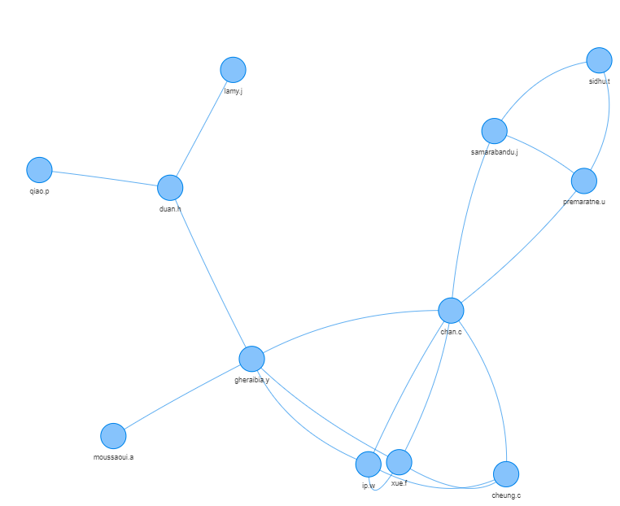

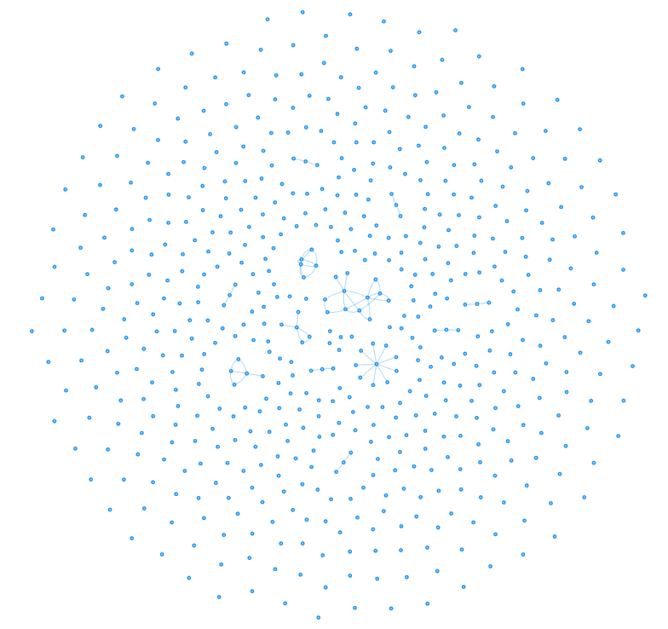
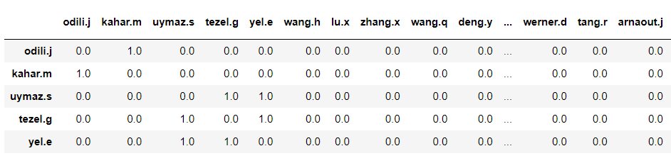
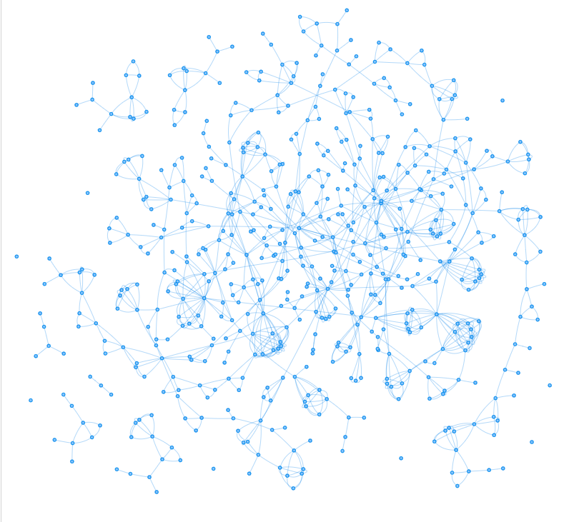
Visualising networks in the Bestiary: discovering author relationships in the meta-heuristics literature Hoa Ngo <190206327@aston.ac.uk> Supervisors: Prof. Aniko Ekart, Dr. Felipe Capelo
Introduction
“If there is one word to describe the society in the early 21st century, it surely must be connected” (National Research Council, 2006). Network appears everywhere and its applications exist in every aspects of life.
The Bestiary is a public repository that gathers hundreds of metaphor-based contributions to the Swarm and Evolutionary Computation literature, with the goal to catalog the exuberance of the meta-heuristic “eco-system”.
The motivation of the project is to visualising the Bestiary’s author networks in a way that helps us understand better the knowledge flow and proliferation of these approaches.
Furthermore, it also focuses on the application of Network science and Graph Theory in Co- authorship Network Analysis (a research branch of Social Network Analysis), providing intelligence on the academic community, authors, scientific collaboration and the Bestiary’ structure of Knowledge.
Methods & Implementation
Bestiary Visualisation
Data processing
To minimize inconsistency from the input data, the authors' names will be converted to lowercase and extracted as: Surname. + First name's Initial
Constructing Adjacency Matrix
A graph/network G can also be described as an n x n adjacency matrix. If there is a connection between any two authors, it is encoded as 1, and 0 otherwise. The weight values of these connections then will be increased by 1 every time the co-authorship relationship between the 2 authors is repeated.
Analysis & Implications
Figure 1. Group of authors collaborating on at least 2 scientific studies
Who are the thought leaders and leading scholars in that field of study? By analyzing some of the network’s properties, we can answer the question.
Network density: It implies how well the authors are connected.
Degree centrality: The most collaborated scholar in the network is also the author with the highest degree of centrality.
Betweenness centrality regulates the flow of information in the network.
Clustering coefficient: analyses the possibility of whether two of a scientist's colleagues have co-authored a paper.
Figure 2. The Bestiary Co-authorship Network

